Slide 1


Chapter 4: Normal bowel in IUS and abnormal findings in IBD
v1.0, 10 December 2022 | EM-121011
For Healthcare Professionals only
Developed under the mentorship of the Asian Organization for Crohn's & Colitis
Supported by Janssen Asia Pacific, a division of Johnson and Johnson International (Singapore) Pte. Ltd. Editorial development by Transform Medical Communications, New Zealand
© Janssen Asia Pacific, a division of Johnson & Johnson International (Singapore) Pte. Ltd.

Slide 2
About IUS Primer module
IUS Primer module was created for training gastroenterologists in Asia on adopting Intestinal Ultrasound (IUS) for the diagnosis and management of Inflammatory Bowel Disease
Transform Medical Communications was commissioned by Janssen Asia Pacific for the development of this educational module under the guidance of IUS Primer working group members and AOCC. The division of Janssen responsible for developing the module is from medical education that follows strict non-promotional and educational guidance.
The development of the module was funded by Janssen Asia Pacific, a division of Johnson and Johnson International (Singapore) Pte. Ltd. in 2022. Non-commercial use of this module is permitted without any further permission, provided credit for the content is clearly attributed to Janssen Asia Pacific.
AOCC: Asian Organization for Crohn's & Colitis; IUS: Intestinal ultrasound.

Slide 3

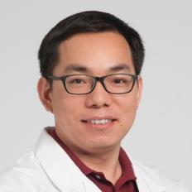
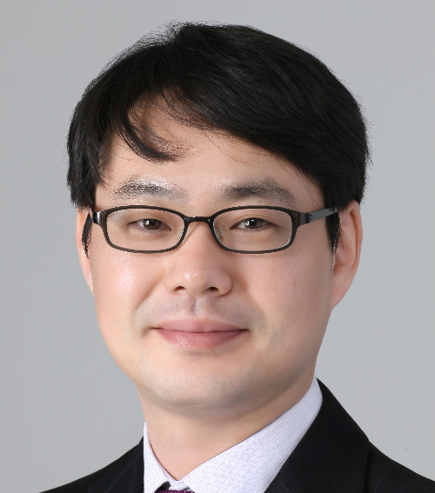

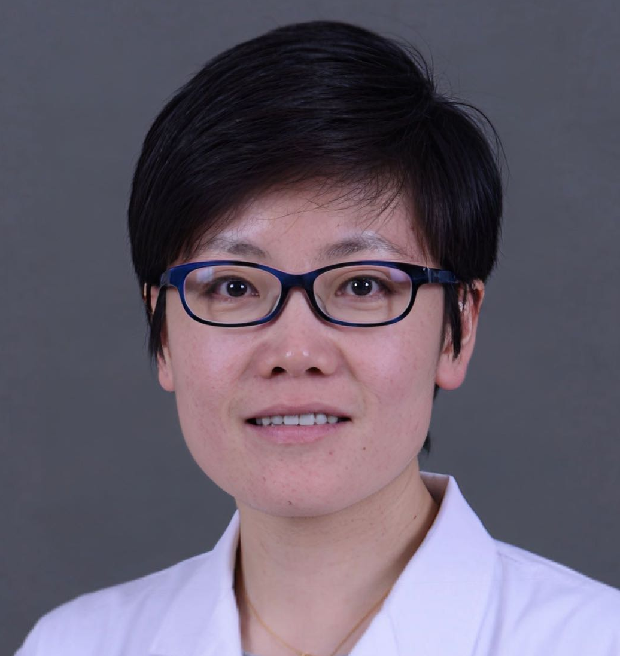


Special thanks to IUS Primer AOCC working group members
Prof. Eun Soo KIM
A/Prof. Ren MAO
Kyungpook National University
First Affiliated Hospital of Sun Yat-sen University
KOREA
CHINA
Prof. Chang Kyun LEE
A/Prof. Jun MIYOSHI
Kyung Hee University
Kyorin University
KOREA
JAPAN
Prof. Yue LI
Dr. Shintaro SAGAMI
Peking Union Medical College Hospital
Kitasato University Kitasato Institute Hospital
CHINA
JAPAN
AOCC: Asian Organization for Crohn's & Colitis; IUS: Intestinal ultrasound; WG: working group.

Slide 4
Learning Objectives
Learn the recognizable 5-layer wall pattern for healthy small bowel, colon, ileocecal valve and appendix on IUS
Explore IUS features* predictive of IBD, including grading for Limberg score
Learn the sensitivity and specificity of IUS for diagnosing IBD versus other imaging techniques
1
2
3
*IUS features include increased BWT, hyperaemia, loss of bowel wall stratification, inflammatory mesenteric fat, lymphadenopathy
BWT: bowel wall thickness; IBD: inflammatory bowel disease; IUS: Intestinal ultrasound; WG: working group
Notes:
Key references
Kucharzik T, Kannengiesser K, Petersen F. The use of ultrasound in inflammatory bowel disease. Ann Gastroenterol. 2017;30(2):135-144. doi:10.20524/aog.2016.0105 https://www.ncbi.nlm.nih.gov/pmc/articles/PMC5320025/
Maconi G, Nylund K, Ripolles T, et al. EFSUMB Recommendations and Clinical Guidelines for Intestinal Ultrasound (GIUS) in Inflammatory Bowel Diseases. EFSUMB-Empfehlungen und klinische Leitlinien für den gastrointestinalen Ultraschall (GIUS) chronisch entzündlichen Darmerkrankungen (CED). Ultraschall Med. 2018;39(3):304-317. https://pubmed.ncbi.nlm.nih.gov/29566419/
Jauregui-Amezaga A, Rimola J. Role of Intestinal Ultrasound in the Management of Patients with Inflammatory Bowel Disease. Life. 2021; 11(7):603. https://doi.org/10.3390/life11070603
Horsthuis K, Bipat S, Bennink RJ, Stoker J. Inflammatory bowel disease diagnosed with US, MR, scintigraphy, and CT: meta-analysis of prospective studies. Radiology. 2008 Apr;247(1):64-79. https://pubmed.ncbi.nlm.nih.gov/18372465/

Slide 5
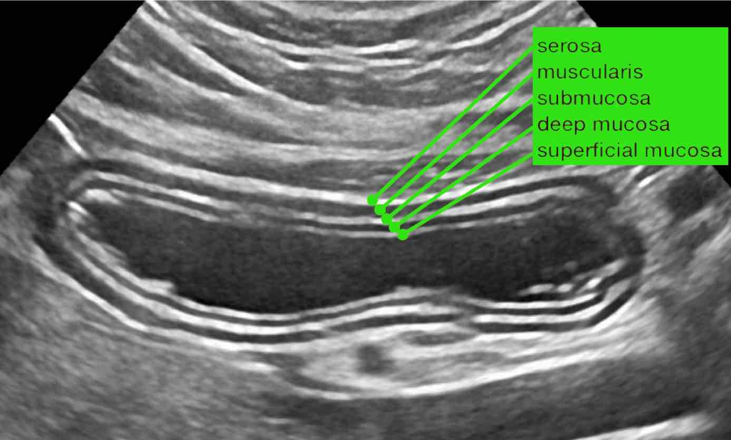
Observing bowel wall layers using IUS
The 5-layer architecture of the bowel wall on IUS is essentially the same from the stomach to the rectum¹
Schematic representation of the 5 layers of the healthy bowel wall^{1,2}
Healthy bowel wall layers as observed on IUS¹
Serosa (hyperechoic white layer, that blends with fat and may not be separately identifiable)
Lumen
Muscularis propria (hypoechoic black layer)
Submucosa
(hyperechoic white layer)
Muscularis mucosae or deep mucosa (hypoechoic black layer)
Mucosa (hyperechoic white layer, that blends with air/ faeces and may not be separately identifiable)
Adapted from Jauregui-Amezaga and Rimola, 2021¹ and Zijta, F., Vanhooymissen, I. & Puylaert, J.²
Image credit: Zijta, F., Vanhooymissen I & Puylaert J, Radiology Assistant website² Reproduced from Radiology Assistant website,² strictly for educational purposes only.
IUS: Intestinal ultrasound
1. Zijta, F., Vanhooymissen, I. & Puylaert, J. Crohn's disease - role of Ultrasound. Available at: https://radiologyassistant.nl/abdomen/bowel/ultrasound-in-crohns-disease.
2. Jauregui-Amezaga, A., & Rimola, J. (2021). Life (Basel, Switzerland), 11(7), 603.
Notes:
The architecture of the bowel wall on IUS is essentially the same from the stomach to the rectum with the five layers, from the bowel lumen:
Mucosa
Deep mucosa (muscularis mucosae)
Submucosa
Muscularis (propria)
Serosa
Jauregui-Amezaga, A., & Rimola, J. (2021). Role of Intestinal Ultrasound in the Management of Patients with Inflammatory Bowel Disease. Life (Basel, Switzerland), 11(7), 603. https://doi.org/10.3390/life11070603

Slide 6
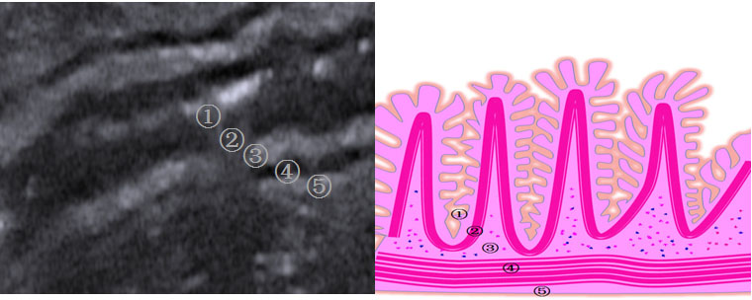
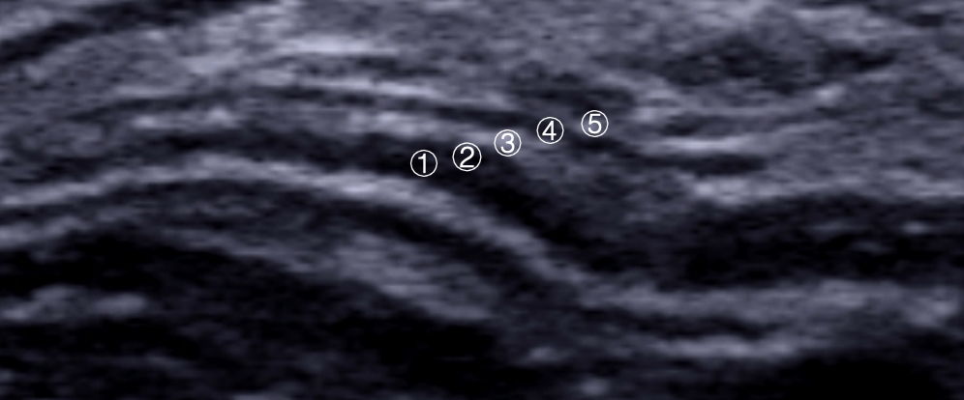
Observing small bowel and appendix on IUS
The 5-layer architecture of the bowel wall on IUS is essentially the same from the stomach to the rectum¹
Small bowel of IUS
Appendix on IUS
Image kindly provided by A/Prof. Ren Mao, First Affiliated Hospital of Sun Yat-sen University, China
Image kindly provided by A/Prof. Ren Mao, First Affiliated Hospital of Sun Yat-sen University, China
① superficial mucosa ② deep mucosa ③ submucosa ④ muscularis propria ⑤ serosa
IUS: Intestinal ultrasound
1. Zijta, F., Vanhooymissen, I. & Puylaert, J. Crohn's disease - role of Ultrasound. Available at: https://radiologyassistant.nl/abdomen/bowel/ultrasound-in-crohns-disease.
Notes:
The architecture of the bowel wall on IUS is essentially the same from the stomach to the rectum with the five layers, from the bowel lumen:
Mucosa
Deep mucosa (muscularis mucosae)
Submucosa
Muscularis (propria)
Serosa
Jauregui-Amezaga, A., & Rimola, J. (2021). Role of Intestinal Ultrasound in the Management of Patients with Inflammatory Bowel Disease. Life (Basel, Switzerland), 11(7), 603. https://doi.org/10.3390/life11070603

Slide 7
Identifying segments of GI tract on IUS
How to perform an ultrasound exam of the gastrointestinal (GI) tract
Click to Play
Watch the video to learn how to identify various segments of the GI tract on IUS (duration: 4 min)
Medmastry. Nov 21, 2017. How to perform an ultrasound exam of the gastrointestinal (GI) tract. YouTube. https://www.youtube.com/watch?v=m4UH3WN9Wtk&ab_channel=Medmastery
GI: gastrointestinal; IUS: Intestinal ultrasound
Notes:
Jauregui-Amezaga, A., & Rimola, J. (2021). Role of Intestinal Ultrasound in the Management of Patients with Inflammatory Bowel Disease. Life (Basel, Switzerland), 11(7), 603. https://doi.org/10.3390/life11070603

Slide 8
Differentiating small bowel from large bowel on IUS
Peristalsis helps differentiate the small intestine from the colon.¹ Small bowel peristalsis is diminished in cases of wall stiffness.¹
Haustra are saccules in the colon that give it its segmented appearance and differentiate it from the small bowel.²
Differentiating small bowel from large bowel (specifically ileum vs cecum)
Click to Play
Watch the video to learn how to differentiate small bowel from large bowel (duration: 2 min)
Sonographic Tendencies, Jan 31, 2022. Differentiating small bowel from large bowel (specifically ileum vs cecum). YouTube. https://www.youtube.com/watch?v=t-jqbgZjFFY&ab_channel=SonographicTendencies
IUS: Intestinal ultrasound
1. Jauregui-Amezaga, A., & Rimola, J. (2021). Life (Basel, Switzerland), 11(7), 603. 2. Azzouz LL, Sharma S. Physiology, Large Intestine. [Updated 2021 Aug 9]. In: StatPearls [Internet]. Treasure Island (FL): StatPearls Publishing; 2022 Jan-. Available from: https://www.ncbi.nlm.nih.gov/books/NBK507857/
Notes:
Jauregui-Amezaga, A., & Rimola, J. (2021). Role of Intestinal Ultrasound in the Management of Patients with Inflammatory Bowel Disease. Life (Basel, Switzerland), 11(7), 603. https://doi.org/10.3390/life11070603

Slide 9
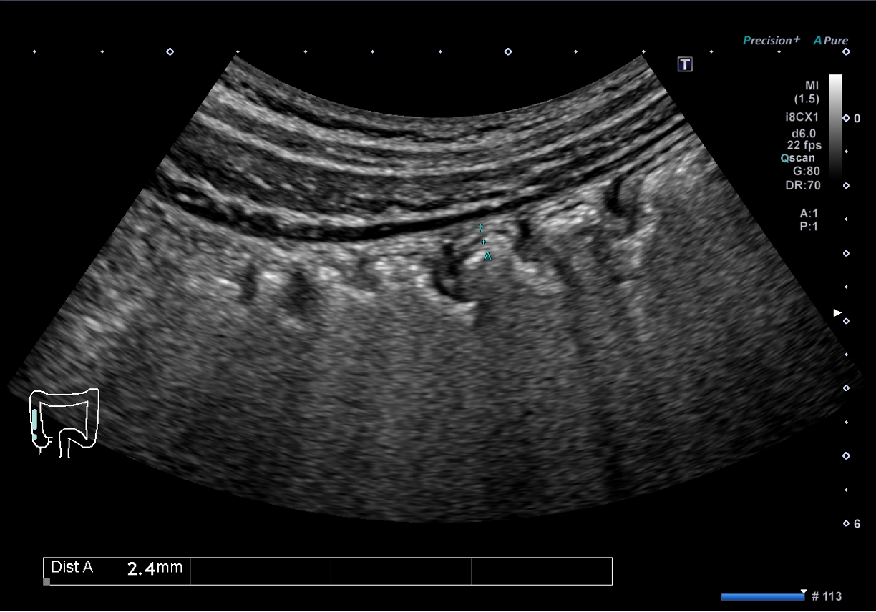
Differentiating small bowel from large bowel on IUS
Haustra (shown by yellow arrows) are saccules in the colon that give it its segmented appearance and differentiate it from the small bowel.¹
Photo kindly provided by A/Prof. Jun Miyoshi, Kyorin University School of Medicine, Japan
IUS: Intestinal ultrasound
1. Azzouz LL, Sharma S. Physiology, Large Intestine. [Updated 2021 Aug 9]. In: StatPearls [Internet]. Treasure Island (FL): StatPearls Publishing; 2022 Jan-. Available from: https://www.ncbi.nlm.nih.gov/books/NBK507857/
Notes:
Jauregui-Amezaga, A., & Rimola, J. (2021). Role of Intestinal Ultrasound in the Management of Patients with Inflammatory Bowel Disease. Life (Basel, Switzerland), 11(7), 603. https://doi.org/10.3390/life11070603

Slide 10
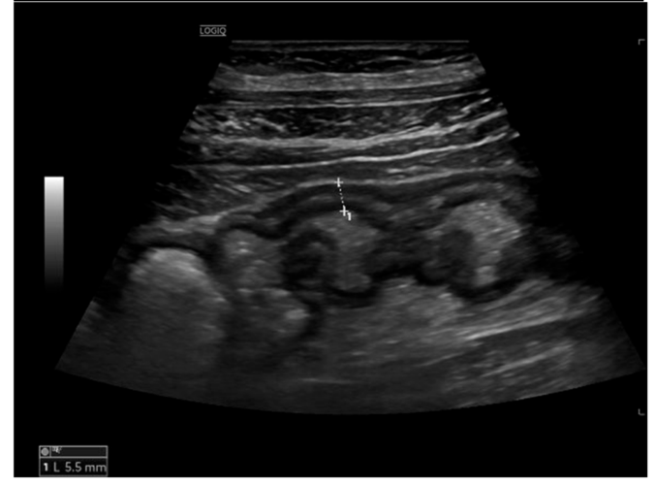
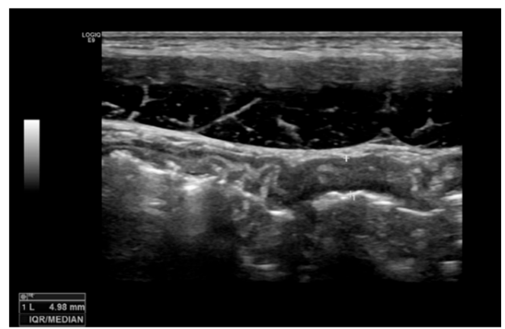
IUS Features predictive of IBD: bowel wall thickness and bowel wall stratification
Bowel wall thickening – most important IUS parameter in IBD
The most commonly used cut-off value is 3 mm
Cut of value | Sensitivity | Specificity
3 mm | 89% | 96%
4 mm | 87% | 98%
Bowel wall thickening without loss of stratification
Bowel wall thickening with loss of stratification
(higher degree of inflammation)
Reproduced from Jauregui-Amezaga and Rimola, 2021 (Attribution 4.0 International (CC BY 4.0). https://creativecommons.org/licenses/by/4.0/legalcode
Reproduced from Jauregui-Amezaga and Rimola, 2021 (Attribution 4.0 International (CC BY 4.0). https://creativecommons.org/licenses/by/4.0/legalcode
BWT: Bowel wall thickness; BWS: bowel wall stratification; IUS: Intestinal ultrasound, IBD: Inflammatory bowel disease
Jauregui-Amezaga, A., & Rimola, J. (2021). Life (Basel, Switzerland), 11(7), 603.
Notes:
Bowel wall echo-pattern or bowel wall stratification (BWS): the bowel wall has a clearly defined multilayered aspect, but stratification can be focally or extensively disrupted or lost due to inflammation. Disruption of stratification is associated to higher degrees of inflammation
Jauregui-Amezaga, A., & Rimola, J. (2021). Role of Intestinal Ultrasound in the Management of Patients with Inflammatory Bowel Disease. Life (Basel, Switzerland), 11(7), 603. https://doi.org/10.3390/life11070603

Slide 11
Measurement of Bowel wall thickness (BWT) on IUS
Measuring BWT on IUS¹
BWT = 5.5 mm in below image (shown as yellow arrow)
BWT is measured by measuring the distance between:^{1,2}
A: the interface between the lumen and mucosal layer
B: the interface between the hypoechoic muscularis mucosa layer and the hyperechoic serosal layer
Steps for measuring BWT
Measures of bowel wall occur in 2 orientations: cross-section and longitudinal. Callipers are placed perpendicular to the wall with 2 measures taken in each orientation, at least 1 cm apart in longitudinal orientation and 90⁰ apart in cross-section. Calliper placement occurs from the interface of the muscosa and muscularis mucosa, to the serosa.²
1 cm
BWT= Average of all 4 measures²
Reproduced from Jauregui-Amezaga and Rimola, 2021 (Attribution 4.0 International (CC BY 4.0). https://creativecommons.org/licenses/by/4.0/legalcode
BWT: Bowel wall thickness; CD: Crohn’s disease; IUS: Intestinal ultrasound; UC: Ulcerative colitis
1.Jauregui-Amezaga, A., & Rimola, J. (2021). Life (Basel, Switzerland), 11(7), 603.
2 Novak, K. L., et al.(2021). Journal of Crohn's and Colitis, 15(4), 609-616.
Notes:
Bowel wall thickening is most prominent in the hyperechoic submucosal layer, representing the deposition of fat and fibrous tissue as a result of chronic bowel inflammation.
In ileocecal Crohn’s disease, typically all bowel wall layers are involved, and the normal stratification is often locally disturbed. US shows marked mural thickening, predominantly in the terminal ileum, but cecum and appendix can also be involved.

Slide 12
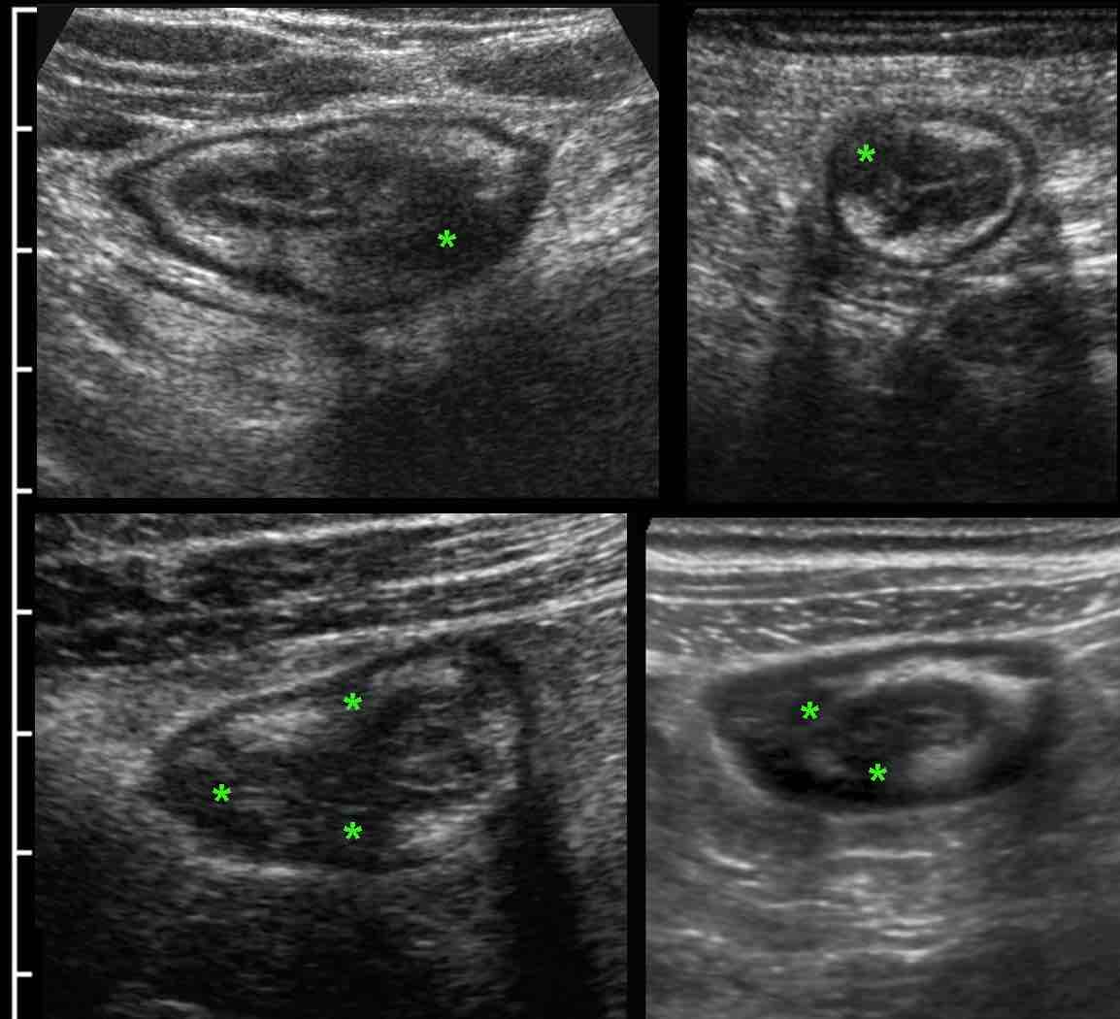
Loss of bowel wall stratification in CD
Transmural signature due to loss of BWS in CD closely correlates with endoscopic findings and active inflammatory histologic changes.¹
The transmural progression in CD is recognizable by focal hypoechoic changes* in the submucosa which is normally hyperechoic¹ (also, referred to as focal disappearance sign²) Broadly, this is mentioned as loss of BWS and is caused by the deep longitudinal ulcer.³
In patients with UC, the inflammation is generally limited to the mucosa.³
Bowel wall thickening involving mucosa and submucosa increased vascularization, and loss of haustra can be seen on IUS in UC.
Stratification of the bowel is usually preserved in UC, but alteration of bowel wall stratification may be present in severe UC*³
Image credit: Zijta, F., Vanhooymissen I & Puylaert J, Radiology Assistant website¹ Reproduced from Radiology Assistant website,¹ strictly for educational purposes only.
*The stratification is usually preserved because UC is not transmural, but it may be disrupted in cases with severe UC activity.
BWS: BWS: bowel wall stratification; CD: Crohn’s disease; IUS: Intestinal ultrasound; UC: Ulcerative colitis
1. K. Kunihiro, J. Hata, K. Haruma, et al. (2004) Scand J Gastroenterol. 39(4)322-6. 2. Zijta, F., Vanhooymissen, I. & Puylaert, J. Crohn's disease - role of Ultrasound. Available at: https://radiologyassistant.nl/abdomen/bowel/ultrasound-in-crohns-disease. 3. Jauregui-Amezaga, A., & Rimola, J. (2021). Life (Basel, Switzerland), 11(7), 603.

Slide 13
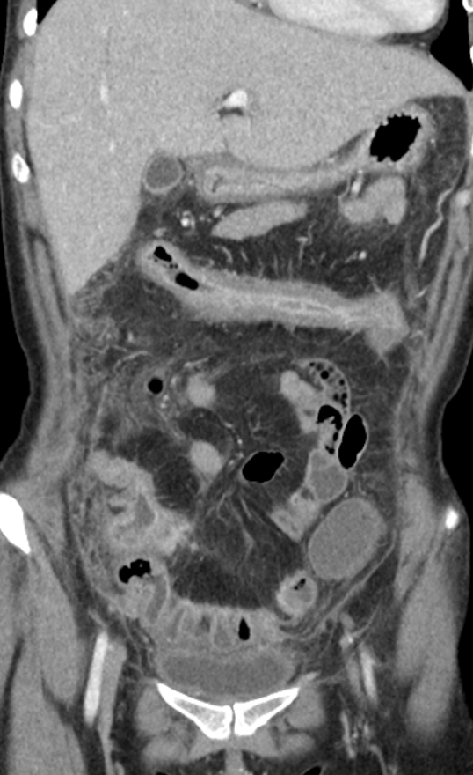
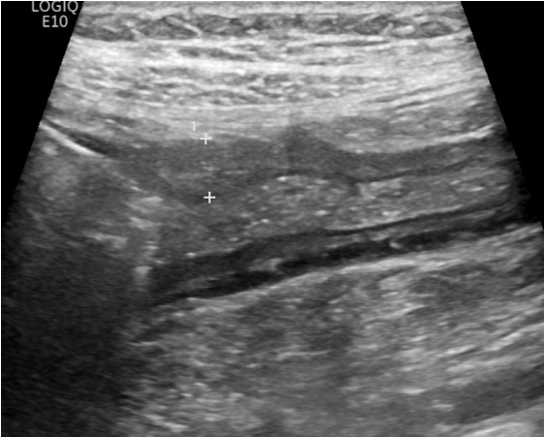
Comparing CT and IUS findings for loss of bowel wall stratification
Loss of BWS (long segment, shown with yellow arrows) in a patient with CD on CT (left) and IUS (right)
Both photos kindly provided by Prof. Chang Kyun Lee, Kyung Hee University, Korea
IUS: Intestinal ultrasound; BWS: BWS: bowel wall stratification; CD: Crohn’s disease.

Slide 14
IUS Features predictive of IBD: bowel wall flow (BWF)
Increased bowel vascularization (Limberg score grade 3) in the inflamed bowel wall¹
Mural and extramural bowel vascularization or BWF is measured at the thickened segments, by colour/ power Doppler IUS, using a semi-quantitative Limberg score:¹
Grade 0: Normal bowel wall with no thickening, well-delineated mural stratification, and no mural flow (no colour Doppler signal)
Grade 1: Thickened bowel wall without vascular signals
Grade 2: Presence of short stretches of vascularity
Grade 3: Presence of longer stretches of vascularity
Grade 4: Vascular signals extending into the surrounding mesentery
Reproduced from Jauregui-Amezaga and Rimola, 2021 (Attribution 4.0 International (CC BY 4.0). https://creativecommons.org/licenses/by/4.0/legalcode
Color Doppler imaging should be used to detect the blood flow in the vessels of the GI and evaluate the vascularization of the pathological bowel wall.²
BWF: Bowel wall flow; IUS: Intestinal ultrasound, IBD: Inflammatory bowel disease
1. Jauregui-Amezaga, A., & Rimola, J. (2021). Life (Basel, Switzerland), 11(7), 603. 2. Nylund, K. (2017). Ultraschall in der Medizin (Stuttgart, Germany : 1980), 38(3), e1–e15.
Notes:
Bowel vascularization or bowel wall flow (BWF) can be measured at the thickened segments, by colour or power Doppler US, using special presets of the
machine optimized for slow flow detection

Slide 15
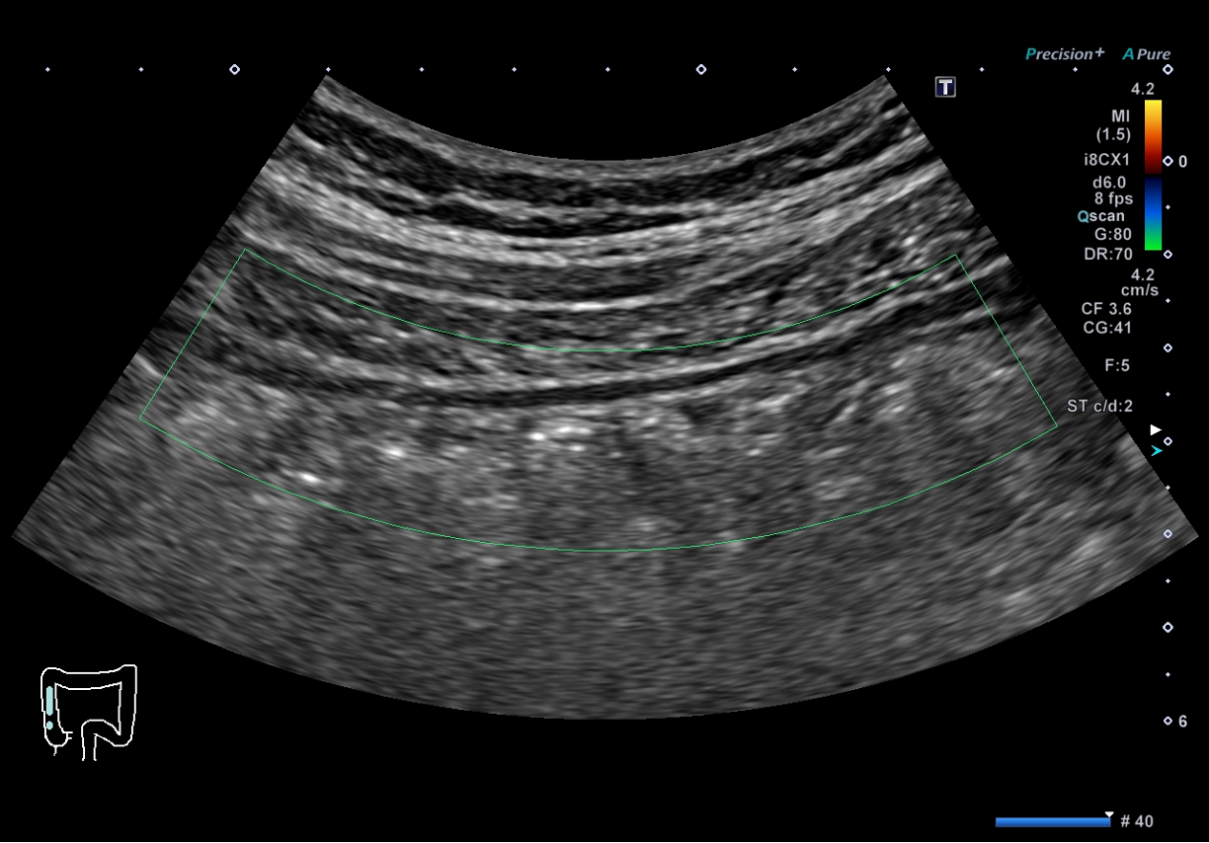
Bowel wall flow - Grade 0 Limberg score
BWF as measured by colour/ power Doppler IUS:
Grade0
Grade 0
Normal bowel wall with no thickening, well-delineated mural stratification, and no mural flow (no colour Doppler signal)¹
Photo kindly provided by A/Prof. Jun Miyoshi, Kyorin University School of Medicine, Japan
BWF: Bowel wall flow; IUS: Intestinal ultrasound
1. Jauregui-Amezaga, A., & Rimola, J. (2021). Life (Basel, Switzerland), 11(7), 603.
Notes:
Bowel vascularization or bowel wall flow (BWF) can be measured at the thickened segments, by colour or power Doppler US, using special presets of the
machine optimized for slow flow detection

Slide 16
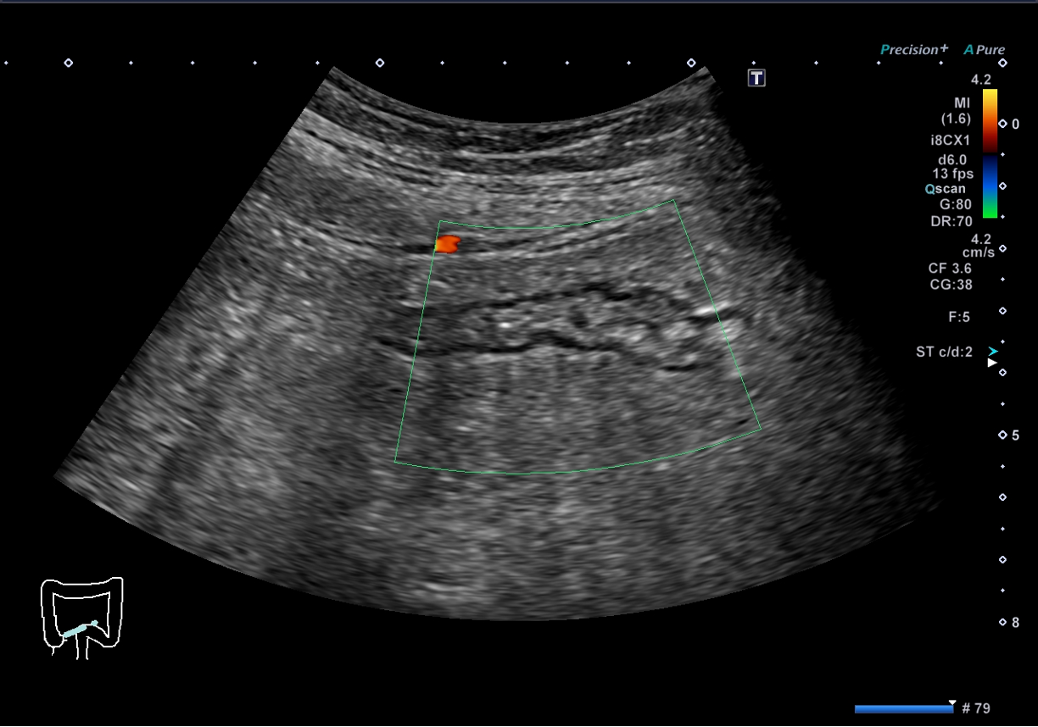
Bowel wall flow - Grade 1 Limberg score
BWF as measured by colour/ power Doppler IUS:
Grade1
Grade 1
Thickened bowel wall without vascular signals¹
Photo kindly provided by A/Prof. Jun Miyoshi, Kyorin University School of Medicine, Japan
BWF: Bowel wall flow; IUS: Intestinal ultrasound
1. Jauregui-Amezaga, A., & Rimola, J. (2021). Life (Basel, Switzerland), 11(7), 603.
Notes:
Bowel vascularization or bowel wall flow (BWF) can be measured at the thickened segments, by colour or power Doppler US, using special presets of the
machine optimized for slow flow detection

Slide 17
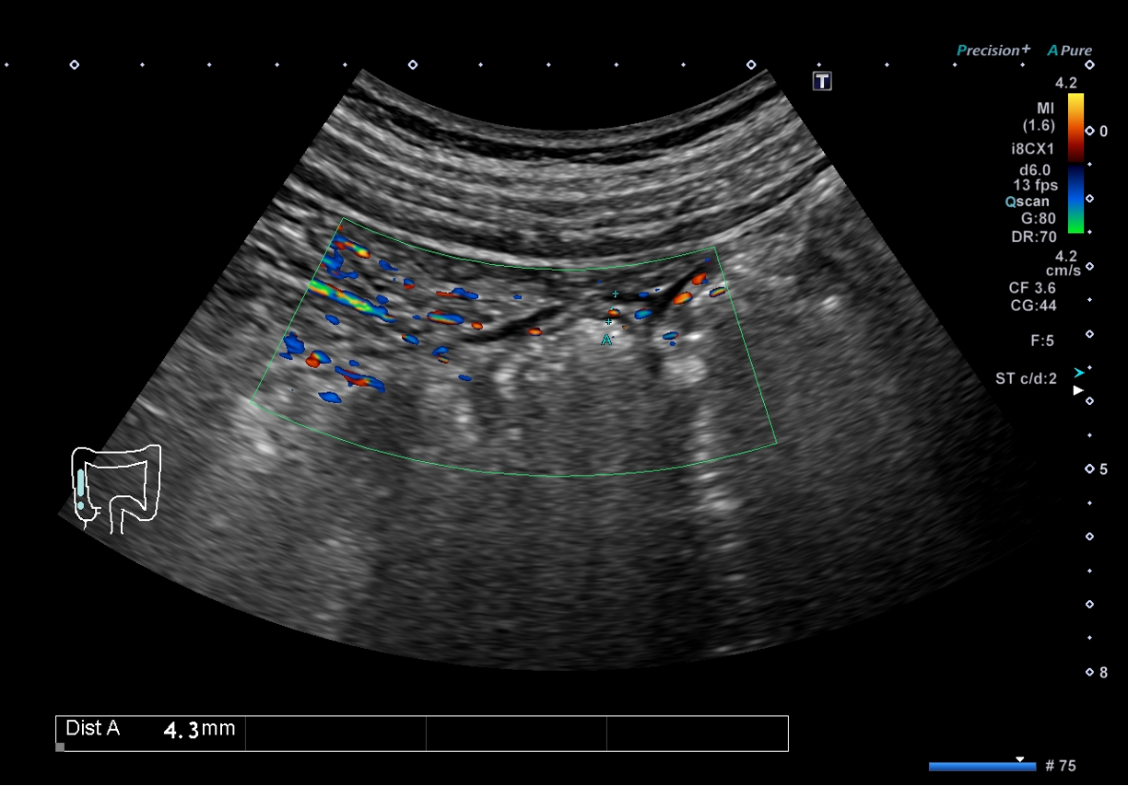
Bowel wall flow - Grade 2 Limberg score
BWF as measured by colour/ power Doppler IUS:
Grade2
Grade 2
Presence of short stretches of vascularity¹
Photo kindly provided by A/Prof. Jun Miyoshi, Kyorin University School of Medicine, Japan
BWF: Bowel wall flow; IUS: Intestinal ultrasound
1. Jauregui-Amezaga, A., & Rimola, J. (2021). Life (Basel, Switzerland), 11(7), 603.
Notes:
Bowel vascularization or bowel wall flow (BWF) can be measured at the thickened segments, by colour or power Doppler US, using special presets of the
machine optimized for slow flow detection

Slide 18
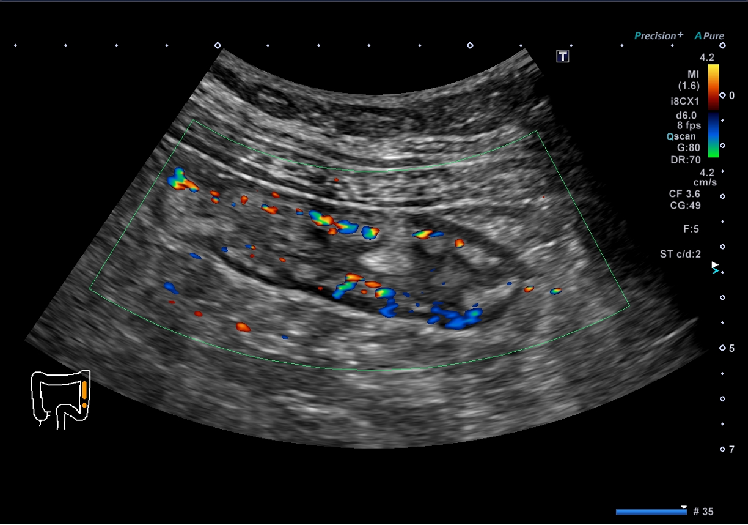
Bowel wall flow - Grade 3 Limberg score
BWF as measured by colour/ power Doppler IUS:
Grade3
Grade 3
Presence of longer stretches of vascularity¹
Photo kindly provided by A/Prof. Jun Miyoshi, Kyorin University School of Medicine, Japan
BWF: Bowel wall flow; IUS: Intestinal ultrasound
1. Jauregui-Amezaga, A., & Rimola, J. (2021). Life (Basel, Switzerland), 11(7), 603.
Notes:
Bowel vascularization or bowel wall flow (BWF) can be measured at the thickened segments, by colour or power Doppler US, using special presets of the
machine optimized for slow flow detection

Slide 19
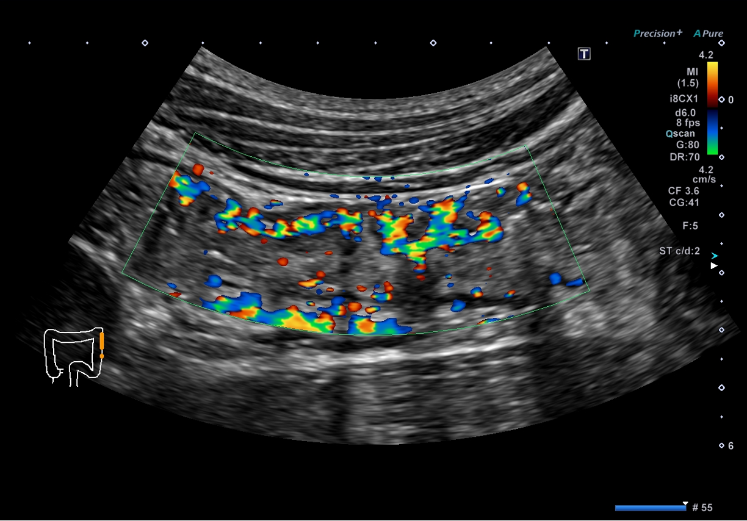
Bowel wall flow - Grade 4 Limberg score
BWF as measured by colour/ power Doppler IUS:
Grade4
Grade 4
Vascular signals extending into the surrounding mesentery¹
Photo kindly provided by A/Prof. Jun Miyoshi, Kyorin University School of Medicine, Japan
BWF: Bowel wall flow; IUS: Intestinal ultrasound
1. Jauregui-Amezaga, A., & Rimola, J. (2021). Life (Basel, Switzerland), 11(7), 603.
Notes:
Bowel vascularization or bowel wall flow (BWF) can be measured at the thickened segments, by colour or power Doppler US, using special presets of the
machine optimized for slow flow detection

Slide 20
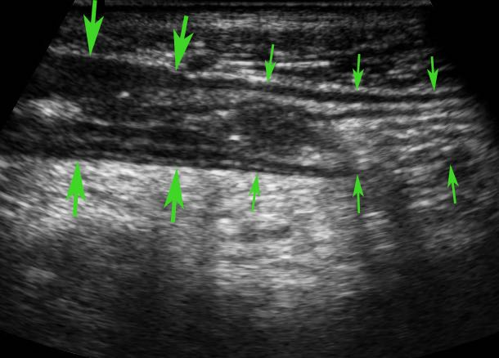
IUS Features in Crohn’s disease: skip lesions
CD affects the bowel in a “patchy” pattern where parts of the bowel are affected
(large green arrows).
While other regions are left intact
(small green arrows).
The affected parts show a relatively sharp demarcation, the transition from normal (small arrows) to abnormal bowel (large arrows) being rather abrupt.
Image credit: Zijta, F., Vanhooymissen I & Puylaert J, Radiology Assistant website¹ Reproduced from Radiology Assistant website,¹ strictly for educational purposes only.
IUS: Intestinal ultrasound. CD: Crohn’s disease.
1. Zijta, F., Vanhooymissen, I. & Puylaert, J. Crohn's disease - role of Ultrasound. Available at: https://radiologyassistant.nl/abdomen/bowel/ultrasound-in-crohns-disease. 2. Jauregui-Amezaga, A., & Rimola, J. (2021). Life (Basel, Switzerland), 11(7), 603.

Slide 21
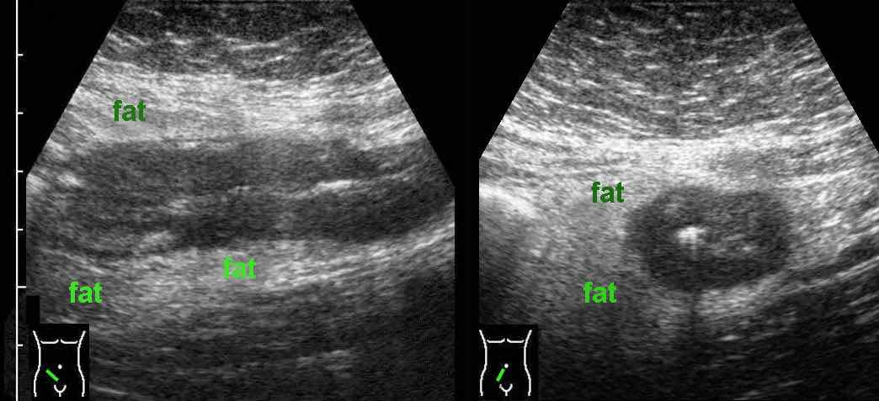
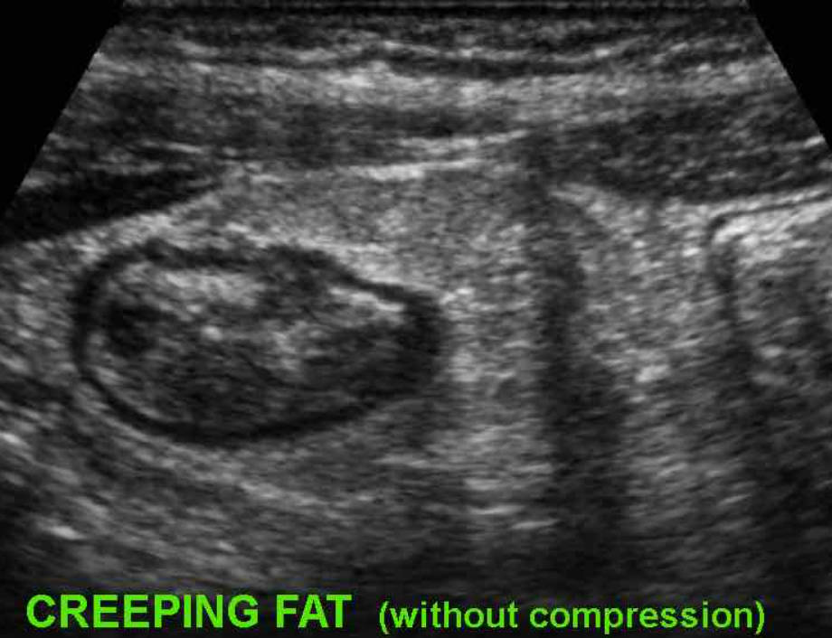
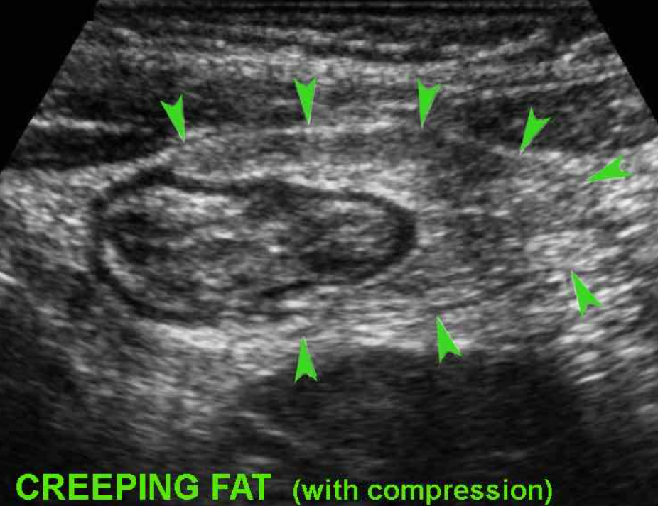
IUS extramural features of IBD: fibrofatty proliferation
Extramural changes within the mesenteric fat might give more information on the inflammatory status of a thickened bowel segment than do alterations of the bowel wall itself. Fibrofatty proliferation appears as a hyperechoic region surrounding the inflamed bowel.^{1,2}
“Creeping fat” represents hypertrophied mesenteric fat “wrapped around” the affected bowel, most frequently in the ileocecal region in longstanding CD.¹
Hyperechoic fatty tissue (fat) around the ileum in CD¹
A “feather-like” pattern observed with ‘Creeping Fat’ in CD during compression¹*
Image credit: Zijta, F., Vanhooymissen I & Puylaert J, Radiology Assistant website¹ Reproduced from Radiology Assistant website,¹ strictly for educational purposes only.
Image credit Zijta, F., Vanhooymissen I & Puylaert J, Radiology Assistant website¹ Reproduced from Radiology Assistant website,¹ strictly for educational purposes only.
*In severe UC, there may be increased echogenicity of the surrounding fat, however that fat is rather well-compressible.¹
CD: Crohn’s Disease; IUS: Intestinal ultrasound. IBD: Inflammatory bowel disease.
1. Zijta, F., Vanhooymissen, I. & Puylaert, J. Crohn's disease - role of Ultrasound. Available at: https://radiologyassistant.nl/abdomen/bowel/ultrasound-in-crohns-disease. 2. Kucharzik, T. (2017). Annals of gastroenterology, 30(2), 135–144.

Slide 22
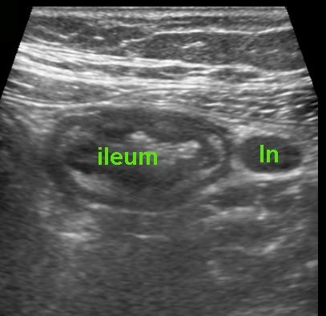
IUS extramural features of IBD: enlarged lymph nodes
Crohn’s ileitis with enlarged mesenteric lymph nodes (ln)¹
Enlarged mesenteric loco-regional lymph nodes are not specific to CD and can be present in other abdominal pathologies (e.g., infectious ileitis with Salmonella typhi).^{1,2}
In CD, these correlate with young age, early disease or disease with shorter duration, and with the presence of fistulae and abscesses.²
Apart from enlarged mesenteric lymph nodes, and fibro-fatty proliferation, the presence of free fluid in the peritoneal cavity is also an extraintestinal feature of active CD.²
Image credit: Zijta, F., Vanhooymissen I & Puylaert J, Radiology Assistant website¹ Reproduced from Radiology Assistant website,¹ strictly for educational purposes only.
CD: Crohn’s Disease; IUS: Intestinal ultrasound. IBD: Inflammatory bowel disease.
1. Zijta, F., Vanhooymissen, I. & Puylaert, J. Crohn's disease - role of Ultrasound. Available at: https://radiologyassistant.nl/abdomen/bowel/ultrasound-in-crohns-disease. 2. Jauregui-Amezaga, A., & Rimola, J. (2021). Life (Basel, Switzerland), 11(7), 603.

Slide 23
Sensitivity and specificity of IUS for diagnosis of IBD
Per patient
Method of diagnosis | Sensitivity | Specificity
IUS | 89.7% | 95.6%
MRI | 93.0% | 92.8%
Scintigraphy | 87.8% | 85.4%
CT | 84.3% | 91.5%
Per bowel segment
Method of diagnosis | Sensitivity | Specificity
IUS | 73.5% | 92.2%
MRI | 70.4% | 94.0%
Scintigraphy | 77.3% | 90.3%
CT | 67.4% | 90.2%
No significant differences in diagnostic accuracy between IUS and MRI
IUS: Intestinal ultrasound. IBD: Inflammatory bowel disease.
Horsthuis, K. (2008). Radiology, 247(1), 64–79.
Notes:
Horsthuis, K., Bipat, S., Bennink, R. J., & Stoker, J. (2008). Inflammatory bowel disease diagnosed with US, MR, scintigraphy, and CT: meta-analysis of prospective studies. Radiology, 247(1), 64–79. https://doi.org/10.1148/radiol.2471070611

Slide 24
Summary of key IUS parameters for evaluation of IBD
IUS parameters | Key features
Bowel wall thickness | Most important parameter for diagnosing IBD. Most commonly used cut-off value is 3mm.
Bowel wall stratification | Disruption of stratification is associated to higher degrees of inflammation
Bowel wall flow/ hyperaemia | Vascularization is most widely measured by the Limberg score. A higher score predicts IBD.
Inflammatory mesenteric fat/ fibrofatty proliferation | Extraintestinal feature of active CD. Looks like hyperechoic tissue surrounding the diseased bowel and is observed in patients with long-standing CD.
IBD, inflammatory bowel disease; CD, Crohn’s disease
Jauregui-Amezaga, A., & Rimola, J. (2021). Life (Basel, Switzerland), 11(7), 603.

